Slide 1
Machine Learning Meets Omics: Explainable AI Strategies for Omics Data Analysis
Helmholtz AI & Helmholtz Munich @ ECCB 2024
17.09.2024

Slide 2
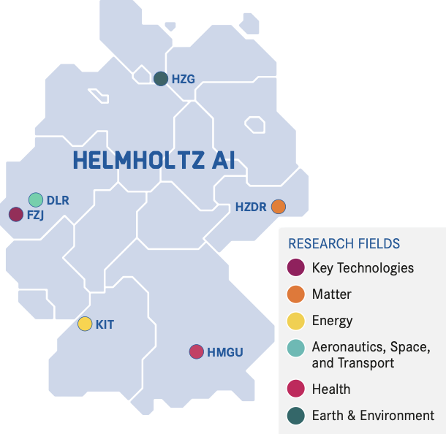






Who are we & what is our mission?
Lisa Barros de Andrade e Sousa
Elisabeth Georgii
Till Richter
Fatemeh Hashemi
We develop novel computational tools powered by AI to accelerate discovery and translation. Collaboratively, we develop predictive algorithms as well as mechanistic models to analyse molecular, imaging, and clinical data of human health and disease.
We empower health researchers with tailored AI solutions, and strive to translate them into reusable tools for the community.

Slide 3

Agenda
ML Best-Practices for Omics Data
Introduction to eXplainable AI (XAI)
Interpretation with Model-Agnostic XAI Methods
Permutation Feature Importance
SHAP (SHapley Additive exPlanations)
Coffee Break
Interpretation with Model-Specific XAI Methods
Forest Guided Clustering
XAI Best-Practices for Omics Data
Wrap-Up
GitHub Repository:
https://tinyurl.com/54d7y2zp

Slide 4
Agenda
ML Best-Practices for Omics Data
Introduction to eXplainable AI (XAI)
Interpretation with Model-Agnostic XAI Methods
Permutation Feature Importance
SHAP (SHapley Additive exPlanations)
Coffee Break
Interpretation with Model-Specific XAI Methods
Forest Guided Clustering
XAI Best-Practices for Omics Data
Wrap-Up
GitHub Repository:
https://tinyurl.com/54d7y2zp

Slide 5


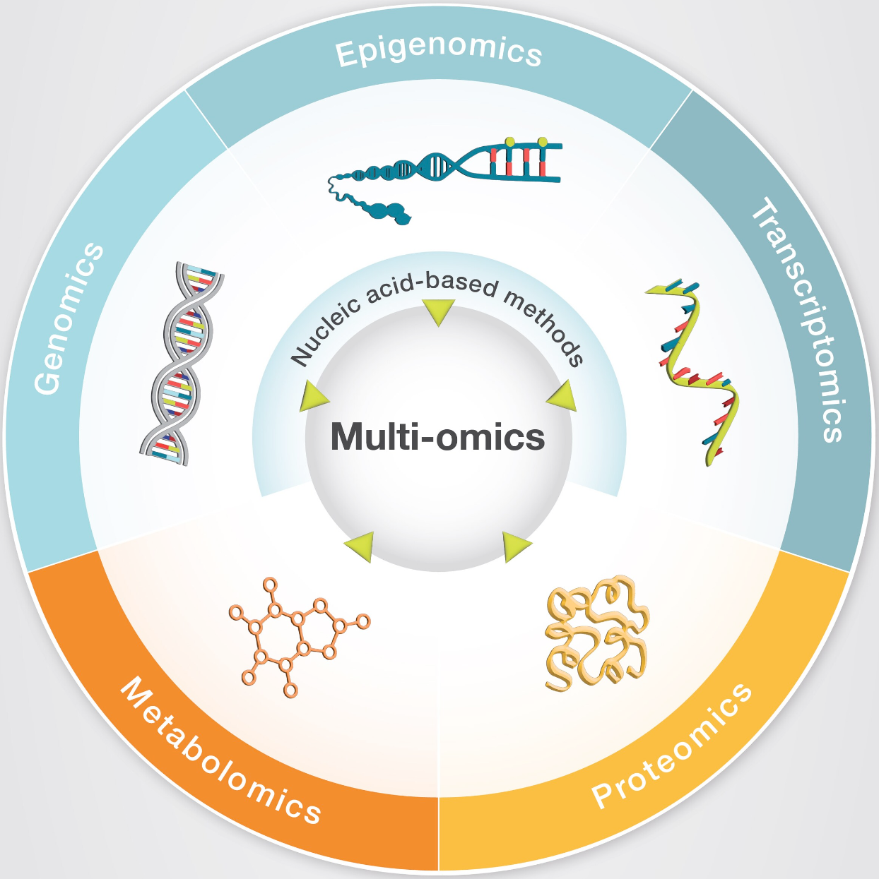
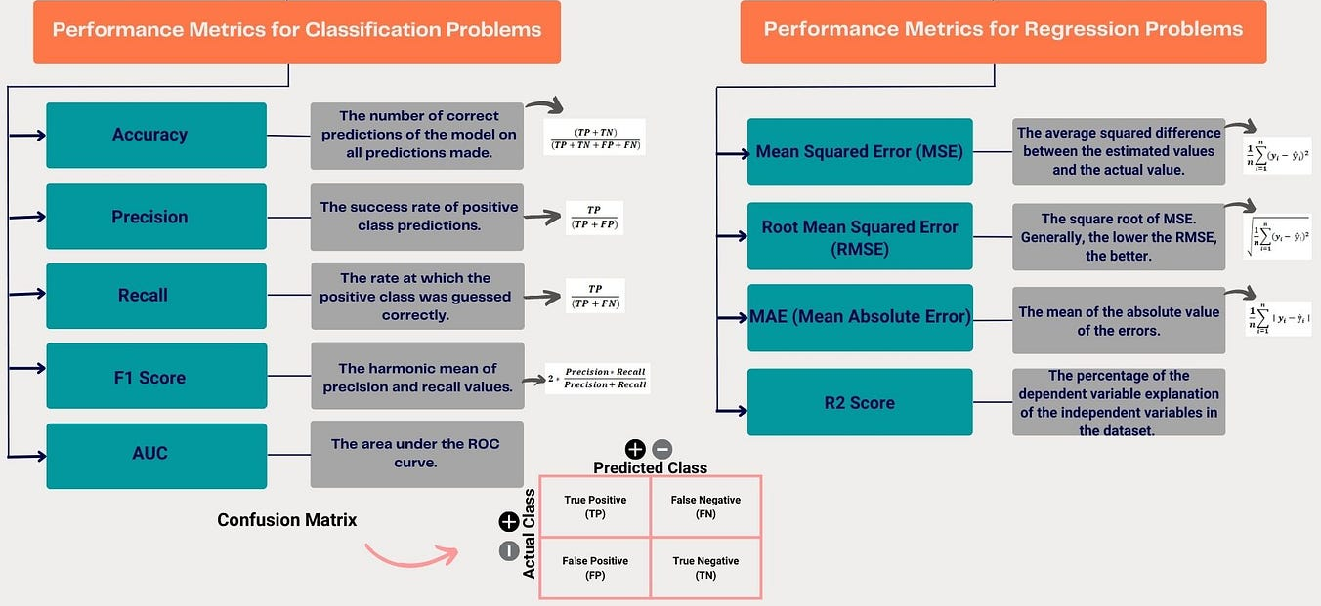




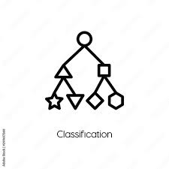
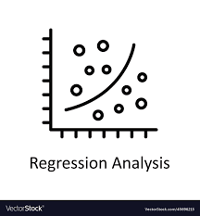


ML Best-Practices for Omics Data
Further Reading:
Artificial intelligence for omics data analysis (https://doi.org/10.1186/s44330-024-00004-5)
Machine learning meets omics: applications and perspectives (https://doi.org/10.1093/bib/bbab460)
General Machine Learning Workflow
Data Preprocessing
Evaluation
Normalization
Missing Value Handling
Quality Control
Replicate Aggregation
Feature Processing
Modelling
Supervised Learning
Standardization
Feature Encoding
Feature Selection
Unsupervised Learning
Data Splitting

Slide 6
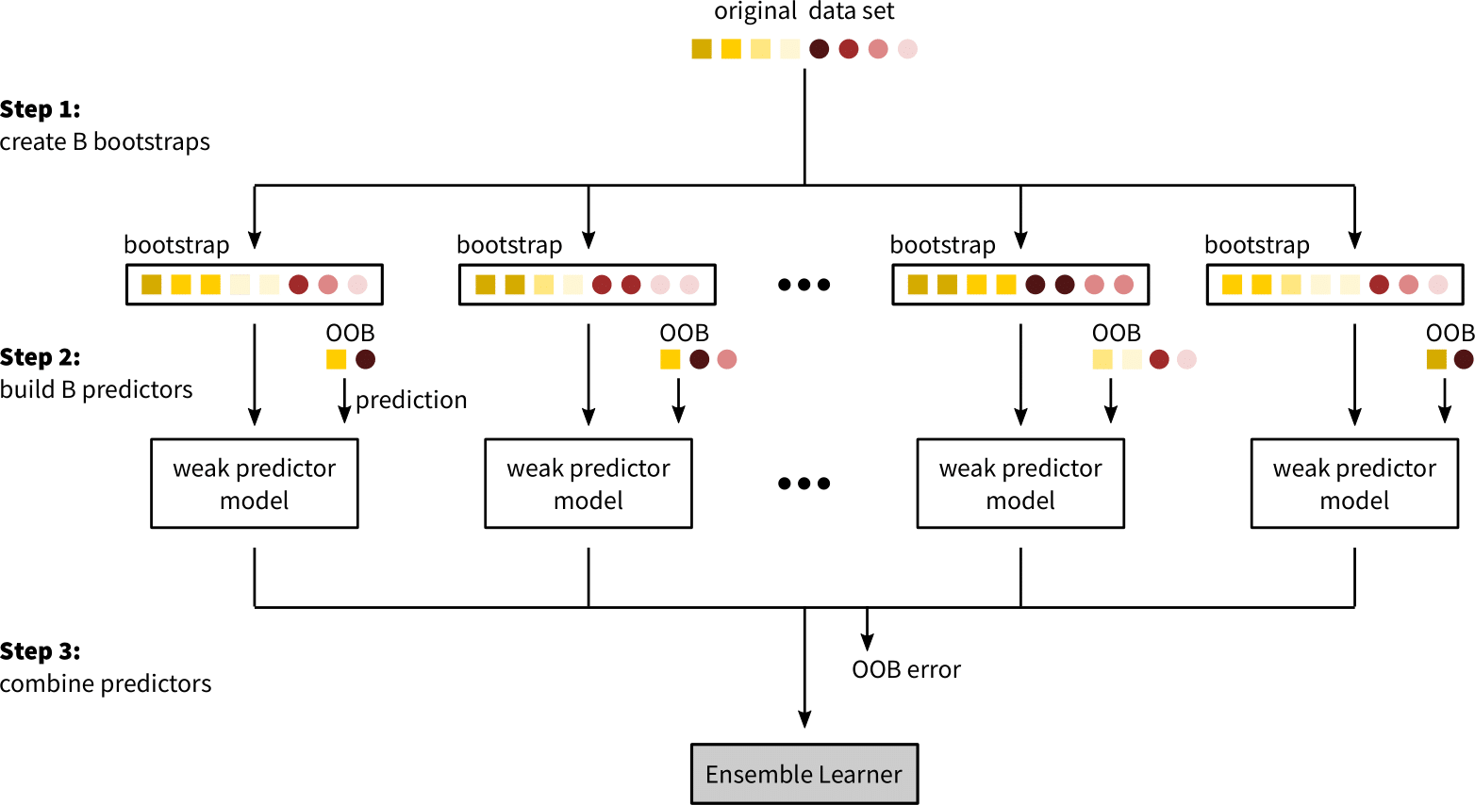
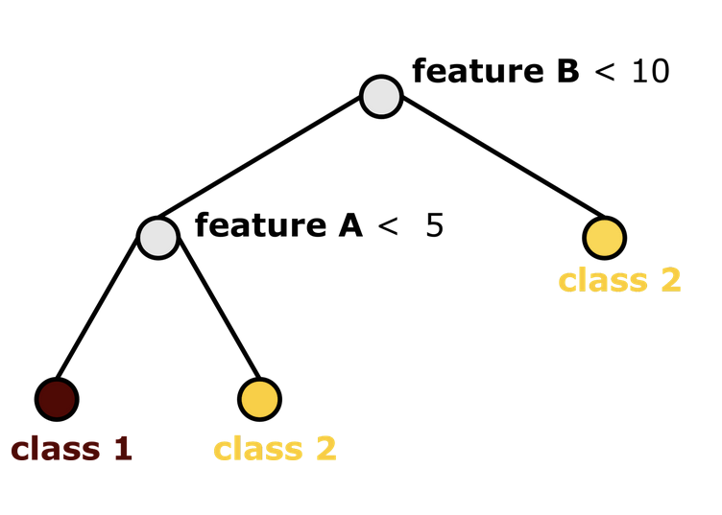
ML Best-Practices for Omics Data
Introduction to Random Forests
Decision Trees
non-parametric supervised learning method used for classification and regression
goal: create a model that predicts the value of a target variable by learning simple decision rules inferred from the features
algorithm: split a node based on the predictor variable X into two daughter nodes to improve the homogeneity of the response variable Y in each daughter node compared to the root node
node impurity for a classification problem can be measured by gini index with values between 0 (high homogeneity) and 1 (low homogeneity)
decision trees are very sensitive to changes in the input data and are prone to overfitting when constructing trees that are too complex
Ensemble Learning
the predictive performance of weak ML models like decision trees can be improved by a technique called ensemble learning, which combines a group of weak predictor models, to form a strong ensemble learner
Bagging: trees are fully grown, hence have a low bias, but predictions are averaged over multiple trees which reduces variance
the variance reduction is limited by the amount of correlation between predictor models, i.e. if decision trees are build on the same set of feature it is common that their structure highly correlates

Slide 7
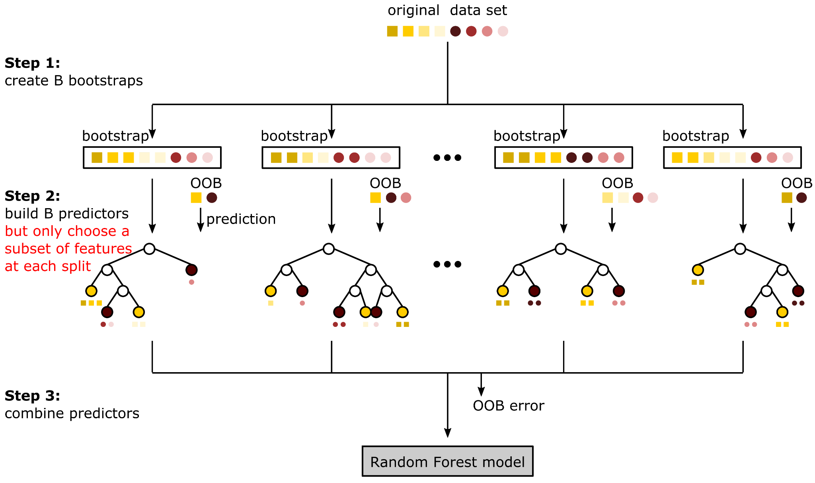
ML Best-Practices for Omics Data
Introduction to Random Forests
Random Forest
the Random Forest (RF) algorithm extends the Bagging algorithm by building an ensemble of decorrelated decision trees
decision trees become correlated if only few features are strong predictors of the response variable, leading to the majority of decision trees having a similar structure and therefore highly correlated predictions
to reduce the correlation between decision trees, RF performs random feature selection at each node prior to the selection of the optimal split, which reduces the chance that strong predictors are always used as first splits
by averaging the predictions over a large ensemble of high variance but low correlation and low bias decision trees, RF is able to efficiently reduce both components - bias and variance - of the generalization error
Now go to Notebook:
1-Tutorial_RandomForest_Models.ipynb

Slide 8
Agenda
ML Best-Practices for Omics Data
Introduction to eXplainable AI (XAI)
Interpretation with Model-Agnostic XAI Methods
Permutation Feature Importance
SHAP (SHapley Additive exPlanations)
Coffee Break
Interpretation with Model-Specific XAI Methods
Forest Guided Clustering
XAI Best-Practices for Omics Data
Wrap-Up
GitHub Repository:
https://tinyurl.com/54d7y2zp

Slide 9
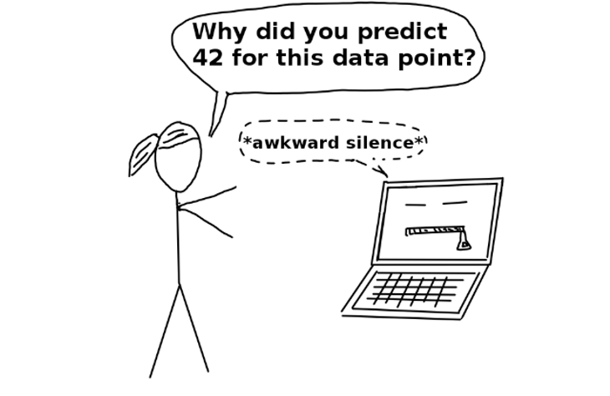
Introduction to eXplainable AI (XAI)
Terminology
Interpretability or Explainability?

Slide 10


Introduction to eXplainable AI (XAI)
Terminology
Interpretability
Understand exactly why and how the model is generating predictions by observing the inner mechanics of the AI/ML method.
Explainability
Focus on the decision-making process and try to explain the behaviour in human understandable terms.
In this course, we will focus only on eXplainable Artificial Intelligence (XAI).

Slide 11
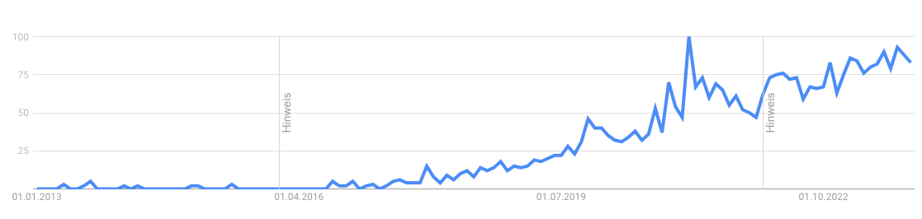
Introduction to eXplainable AI (XAI)
Why is explainability important?
Google Trends Popularity Index of the term "Explainable AI" over the last ten years (2013–2023)

Slide 12

Introduction to eXplainable AI (XAI)
Why is explainability important?
„The problem is that a single metric, such as classification accuracy, is an incomplete description of most real-world tasks.” — (Doshi-Velez et al., 2017)

Slide 13







Introduction to eXplainable AI (XAI)
Integration of XAI into your Machine Learning workflow
Input Data
ML / DL Model
Output
Explanation
But there were puzzling findings among them, some readers noticed. Although the work identified many human bacteria in cancerous tissues, there was, in addition to the mysterious seaweed bacterium, a marine hydrothermal vent bacterium linked to prostate cancer, and a coral bacterium associated with melanoma. - Science Insider (https://doi.org/10.1126/science.adk1012)
XAI Method
Domain Knowledge

Slide 14
Introduction to eXplainable AI (XAI)
Integration of XAI into your Machine Learning workflow
ML model
Is my model directly interpretable?
Interpretability
(intrinsic)
Explainability
(post-hoc)
yes
no
Great! Your model is a glass-box!
Shoot! Your model is a black-box, you should consider XAI methods!

Slide 15

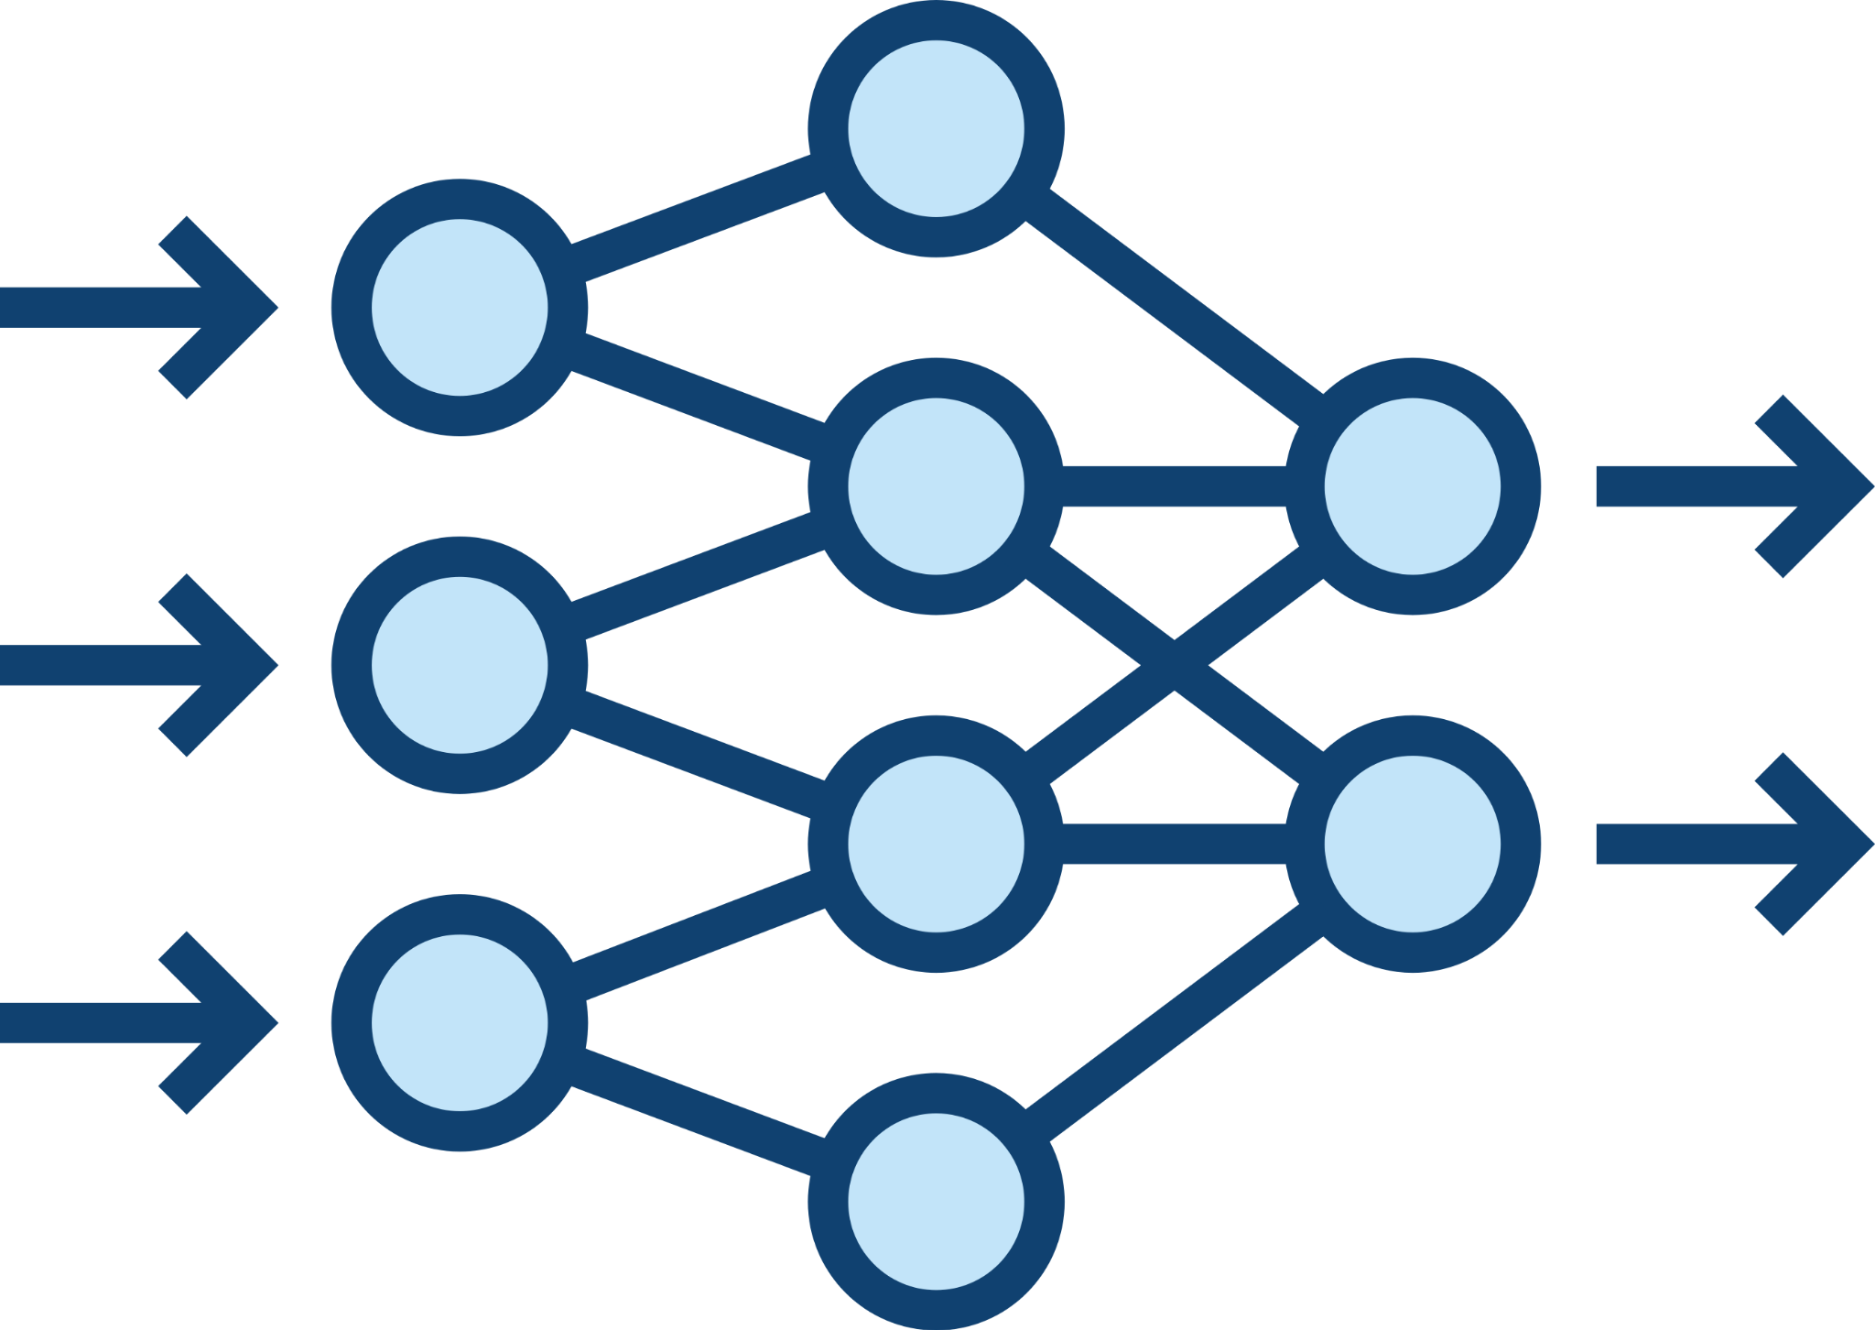


Introduction to eXplainable AI (XAI)
Integration of XAI into your Machine Learning workflow
ML model
model-agnostic
Is my model directly interpretable?
no
Interpretability
(intrinsic)
Explainability
(post-hoc)
Is the interpretation method specific for a certain model type?
yes
no
Does the method describe the average behaviour of the model?
yes
model-specific
local
global
no
yes

Slide 16
Introduction to eXplainable AI (XAI)
Integration of XAI into your Machine Learning workflow
Model-Agnostic
Partial Dependence Plots
Local Interpretable Model-Agnostic Explanations (LIME)
Global Surrogate
Feature Importance
Shapley Values
Global
CAM
Local
Attacking for Interpretability
Integrated Gradients (IG)
Global Attribution Mapping
Attention Maps
Forest-Guided Clustering (FGC)
Grad-CAM
Model-Specific

Slide 17
Agenda
ML Best-Practices for Omics Data
Introduction to eXplainable AI (XAI)
Interpretation with Model-Agnostic XAI Methods
Permutation Feature Importance
SHAP (SHapley Additive exPlanations)
Coffee Break
Interpretation with Model-Specific XAI Methods
Forest Guided Clustering
XAI Best-Practices for Omics Data
Wrap-Up
GitHub Repository:
https://tinyurl.com/54d7y2zp

Slide 18
Interpretation with Model-Agnostic XAI Methods
Permutation Feature Importance
Idea: measure the importance of a feature as an increase in loss when the feature is permuted
x1
x2
x3
x4
y
x1
x2
x3
x4
y
patient 1
patient 1
patient 2
patient 2
Permutation breaks the relationship between the feature and the true outcome.
patient 3
patient 3
patient 4
patient 4
patient 5
patient 5
patient 6
patient 6
patient 7
patient 7

Slide 19
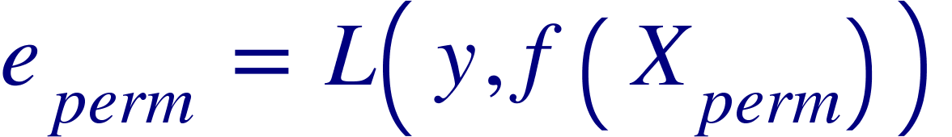
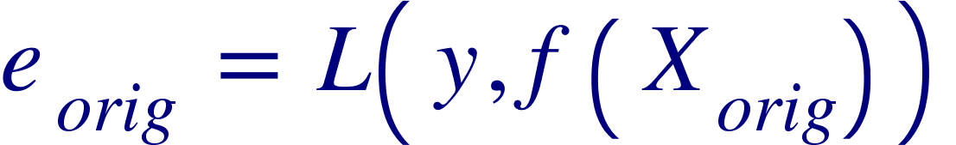
Interpretation with Model-Agnostic XAI Methods
Permutation Feature Importance
Idea: measure the importance of a feature as an increase in loss when the feature is permuted
x1
x2
x3
x4
y
x1
x2
x3
x4
y
patient 1
patient 1
patient 2
patient 2
patient 3
patient 3
patient 4
patient 4
patient 5
patient 5
patient 6
patient 6
patient 7
patient 7

Slide 20




Interpretation with Model-Agnostic XAI Methods
Permutation Feature Importance
Idea: measure the importance of a feature as an increase in loss when the feature is permuted
x1
x2
x3
x4
y
x1
x2
x3
x4
y
patient 1
patient 1
patient 2
patient 2
patient 3
patient 3
patient 4
patient 4
patient 5
patient 5
patient 6
patient 6
patient 7
patient 7

Slide 21
Interpretation with Model-Agnostic XAI Methods
Permutation Feature Importance
Advantages
Straightforward interpretation: indicates the increase in model error when the feature's information is destroyed.
By permuting the feature, the interaction effects with other features is destroyed: Feature importance takes into account both the main feature effect and the interaction effects on model performance.
Disadvantages
Feature permutation is a random process: Results might vary greatly when permutation is repeated.
Feature Importance assumes feature independence: Importance might be split between correlated features.
Purely global method: does not provide local explanations.
Now go to Notebook:
2-Tutorial_PermutationFeatureImportance.ipynb

Slide 22
Interpretation with Model-Agnostic XAI Methods
SHAP (SHapley Additive exPlanations)
Idea: give local explanation for single instances by computing the contribution of each feature to the prediction
SHAP efficiently estimates Shapley values, and provides additional global interpretation methods based on aggregations of Shapley values.

Slide 23
Interpretation with Model-Agnostic XAI Methods
SHAP (SHapley Additive exPlanations)
Idea: give local explanation for single instances by computing the contribution of each feature to the prediction
In contrast to Permutation Feature Importance, which is based on performance metrics, SHAP looks at the output values predicted by a model
For classification problems, the predicted value is a class probability
For regression problems, the predicted value is a numeric value
For a single instance, the predicted value is expressed as a sum of a baseline value and a sum of feature-specific contributions
The baseline value is typically the overall expected output value (can be approximated by the mean of predicted values on training data)

Slide 24
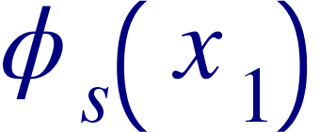
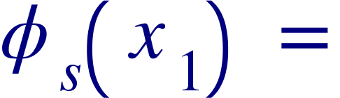
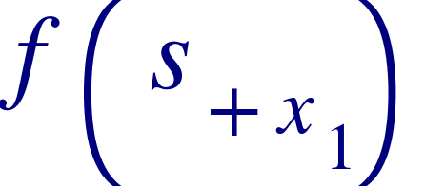
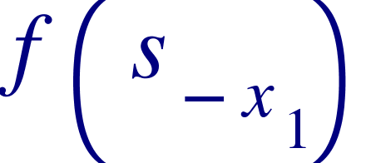

Interpretation with Model-Agnostic XAI Methods
SHAP (SHapley Additive exPlanations)
Idea: give local explanation for single instances by computing the contribution of each feature to the prediction
x1
x2
x3
x4
y
x1
x2
x3
x4
patient 1
patient 4
patient 2
patient 3
patient 4
marginal contribution for different feature sets s
patient 5
patient 6
patient 7
f : black-box model

Slide 25
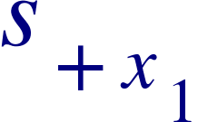
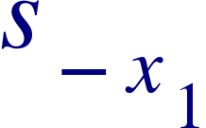
Interpretation with Model-Agnostic XAI Methods
SHAP (SHapley Additive exPlanations)
Idea: give local explanation for single instances by computing the contribution of each feature to the prediction
x1
x2
x3
x4
y
x1
x2
x3
x4
patient 1
patient 4
patient 2
patient 3
patient 4
marginal contribution for different feature sets s
patient 5
patient 6
patient 7

Slide 26
Interpretation with Model-Agnostic XAI Methods
SHAP (SHapley Additive exPlanations)
Idea: give local explanation for single instances by computing the contribution of each feature to the prediction
x1
x2
x3
x4
y
x1
x2
x3
x4
patient 1
patient 4
patient 2
patient 3
patient 4
marginal contribution for different feature sets s
patient 5
patient 6
patient 7

Slide 27
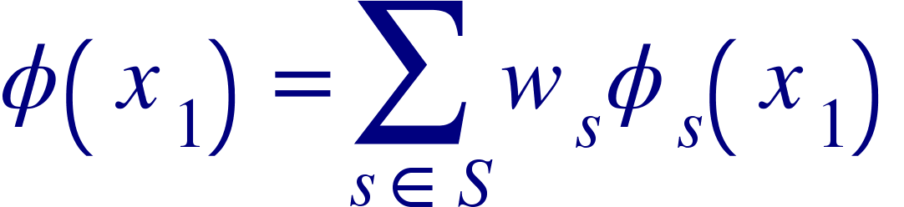
Interpretation with Model-Agnostic XAI Methods
SHAP (SHapley Additive exPlanations)
Idea: give local explanation for single instances by computing the contribution of each feature to the prediction
x1
x2
x3
x4
y
x1
x2
x3
x4
patient 1
patient 4
patient 2
patient 3
patient 4
patient 5
patient 6
patient 7
smallest and largest sets have the highest weights
Shapley value (contribution):

Slide 28
Interpretation with Model-Agnostic XAI Methods
SHAP (SHapley Additive exPlanations)
Advantages
The fast computation of Shapley values makes it possible to compute the many Shapley values needed for global model interpretations.
SHAP provides local and global interpretations, which are consistent, since the Shapley values are the atomic unit of the global interpretations.
Disadvantages
SHAP assumes feature independence: Importance might be split between correlated features.
Now go to Notebook:
3-Tutorial_SHAP.ipynb

Slide 29
Agenda
ML Best-Practices for Omics Data
Introduction to eXplainable AI (XAI)
Interpretation with Model-Agnostic XAI Methods
Permutation Feature Importance
SHAP (SHapley Additive exPlanations)
Coffee Break
Interpretation with Model-Specific XAI Methods
Forest Guided Clustering
XAI Best-Practices for Omics Data
Wrap-Up
GitHub Repository:
https://tinyurl.com/54d7y2zp

Slide 30
Agenda
ML Best-Practices for Omics Data
Introduction to eXplainable AI (XAI)
Interpretation with Model-Agnostic XAI Methods
Permutation Feature Importance
SHAP (SHapley Additive exPlanations)
Coffee Break
Interpretation with Model-Specific XAI Methods
Forest Guided Clustering
XAI Best-Practices for Omics Data
Wrap-Up
GitHub Repository:
https://tinyurl.com/54d7y2zp

Slide 31
Interpretation with Model-Specific XAI Methods
Forest Guided Clustering
Idea: explain the decision-making process of a Random Forest model by grouping the data into subgroups of instances that follow similar decision paths in the Random Forest model

Slide 32
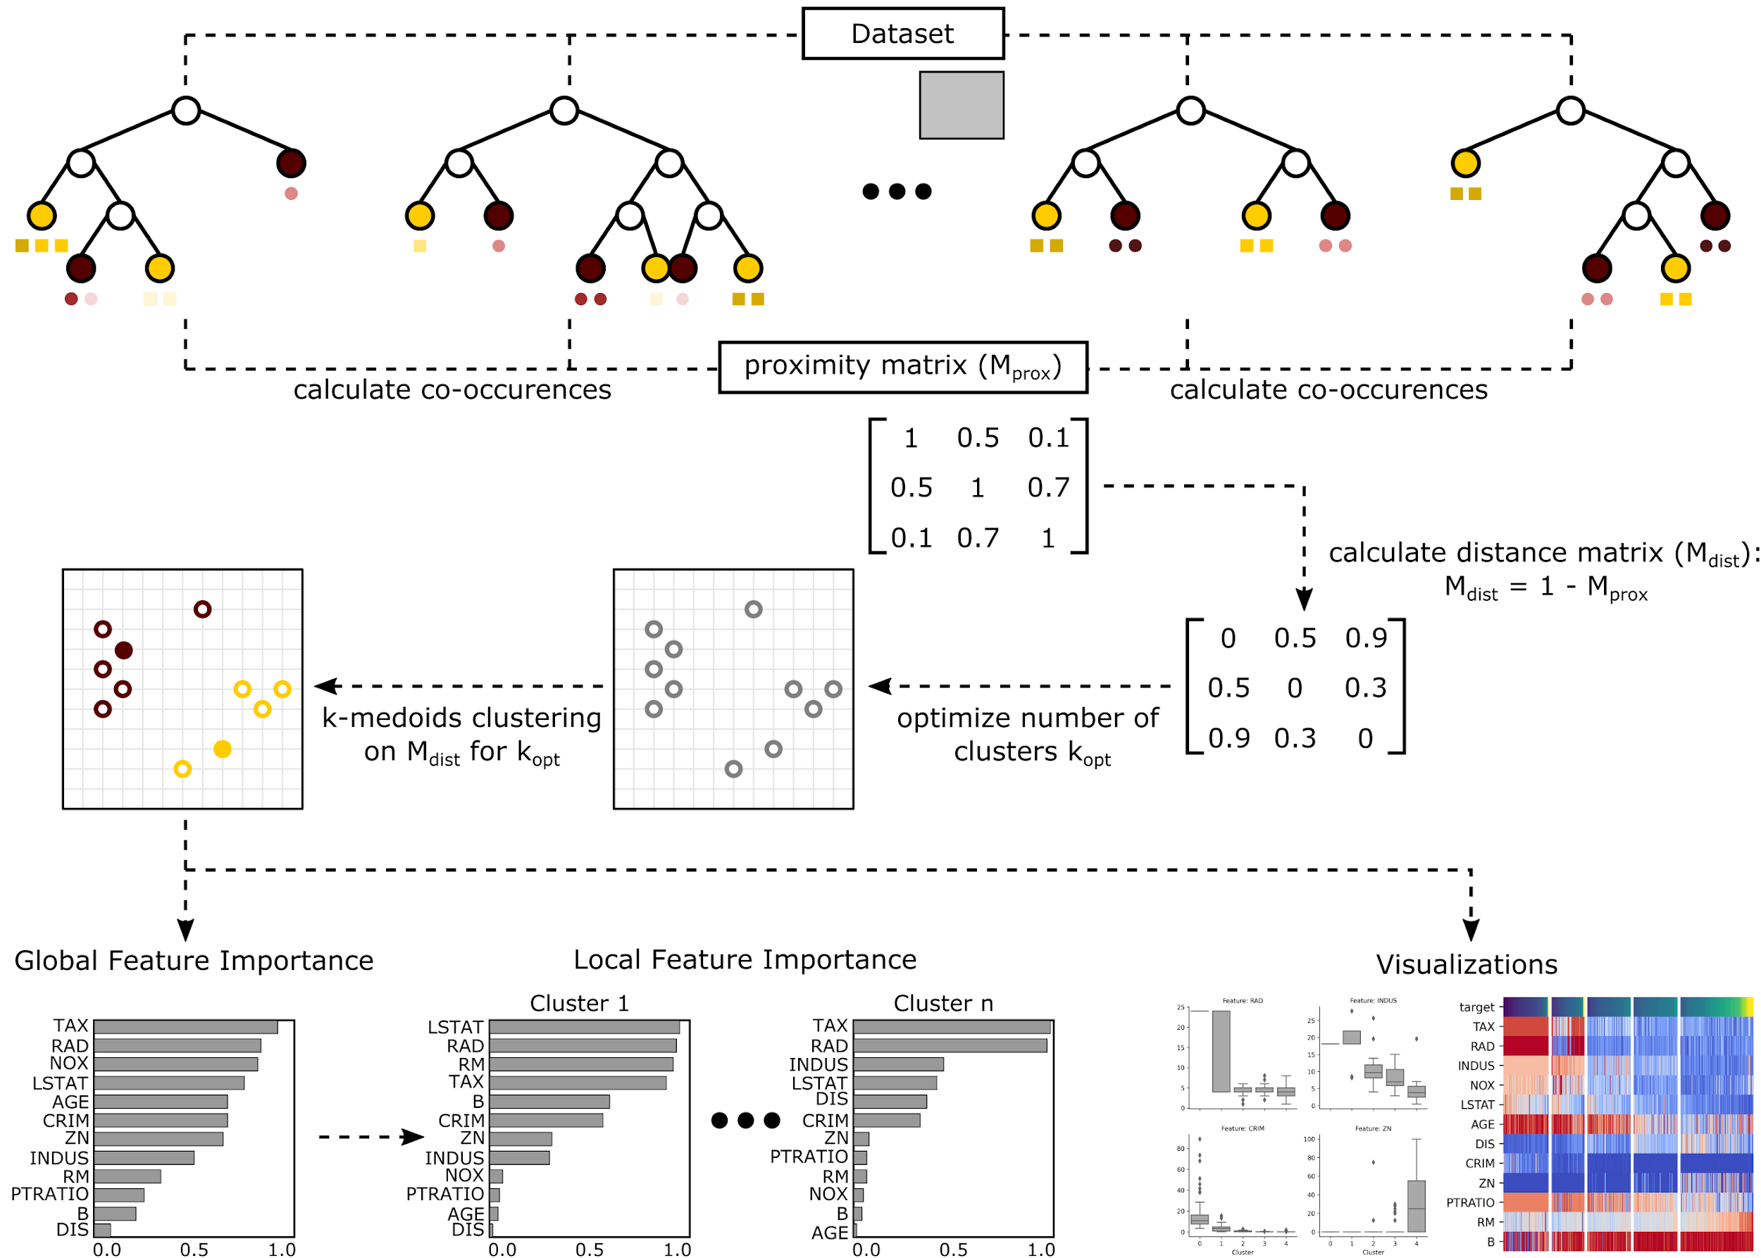
Interpretation with Model-Specific XAI Methods
User Input:
Target values
Feature matrix
Random Forest model
Forest Guided Clustering

Slide 33
Interpretation with Model-Specific XAI Methods
User Input:
Target values
Feature matrix
Random Forest model
Forest Guided Clustering
Use the structure of the Random Forest model to define a similarity between data points.

Slide 34
Interpretation with Model-Specific XAI Methods
User Input:
Target values
Feature matrix
Random Forest model
Forest Guided Clustering
Cluster data points according to their similarity and use target values to optimize number of clusters.
Use the structure of the Random Forest model to define a similarity between data points.

Slide 35
Interpretation with Model-Specific XAI Methods
User Input:
Target values
Feature matrix
Random Forest model
Forest Guided Clustering
Cluster data points according to their similarity and use target values to optimize number of clusters.
Use the structure of the Random Forest model to define a similarity between data points.
Features that show different and concise value distributions across clusters are defined to be globally or locally important.
Visualize feature pattern that define each cluster.

Slide 36
Interpretation with Model-Specific XAI Methods
Forest Guided Clustering
Advantages
Forest-Guided Clustering does not assume feature independence: feature correlation does not affect the importance measure.
Local Feature Importance allows to understand the relevance of each feature for a specific cluster.
Forest-Guided Clustering allows us to look inside the decision-making process of a Random Forest model, and thereby helps to uncover distinct feature patterns that define different subgroups of instances in our data.
Disadvantages
Forest-Guided Clustering is limited to Random Forest models.
Now go to Notebook:
4-Tutorial_FGC.ipynb

Slide 37
Agenda
ML Best-Practices for Omics Data
Introduction to eXplainable AI (XAI)
Interpretation with Model-Agnostic XAI Methods
Permutation Feature Importance
SHAP (SHapley Additive exPlanations)
Coffee Break
Interpretation with Model-Specific XAI Methods
Forest Guided Clustering
XAI Best-Practices for Omics Data
Wrap-Up
GitHub Repository:
https://tinyurl.com/54d7y2zp

Slide 38
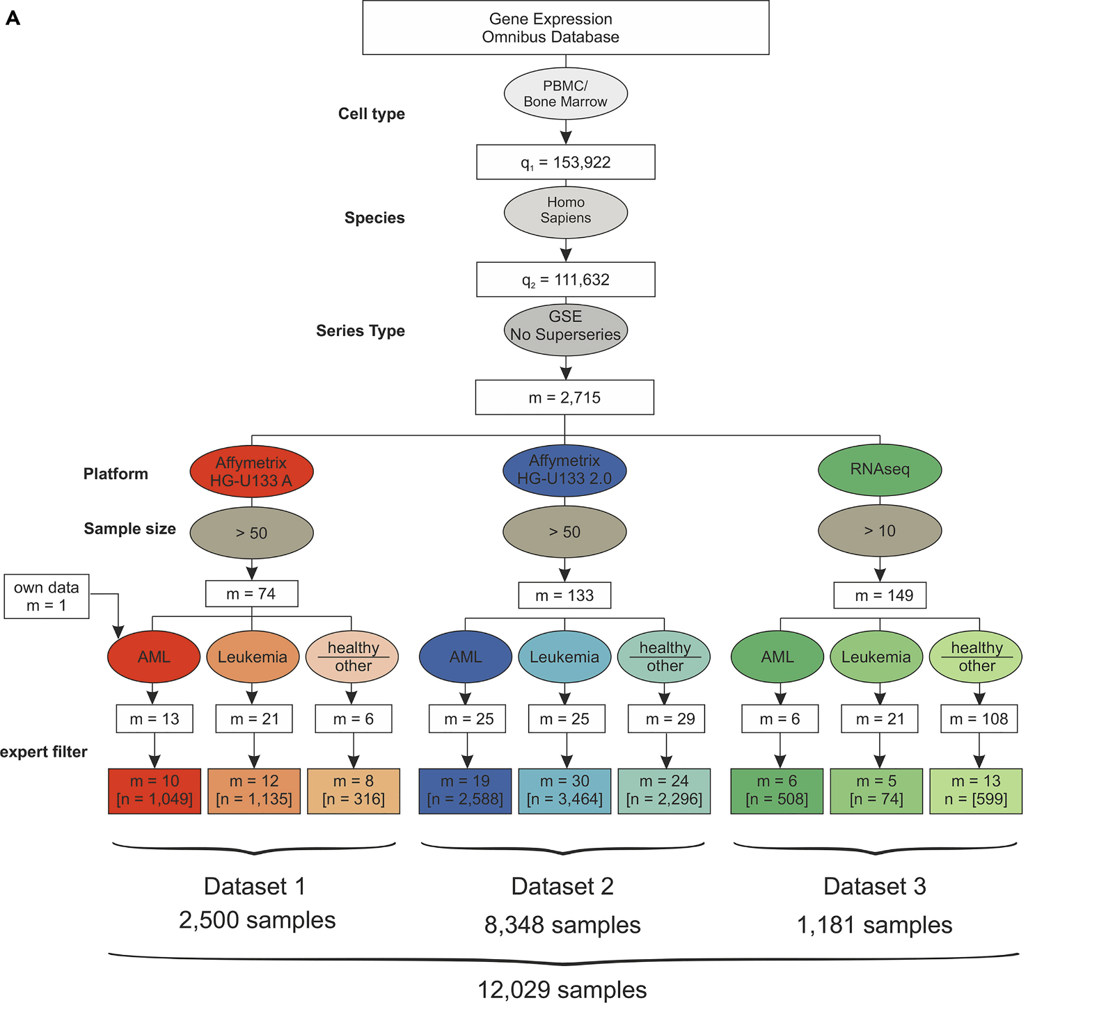
XAI Best-Practices for Omics Data
Comparison of different XAI methods on Acute Myeloid Leukemia Dataset
Dataset Source:
Warnat-Herresthal et al. (2020). Scalable prediction of acute myeloid leukemia using high-dimensional machine learning and blood transcriptomics.
https://doi.org/10.1016/j.isci.2019.100780
Dataset Description:
The gene expression omnibus (GEO) database was systematically searched for GEO Series of human PBMC and bone marrow samples processed with microarray platforms (Affymetrix HG-U133A and HG-U133 2.0) or next-generation RNA sequencing (RNA-seq) data. These data were filtered for inclusion of AML samples, samples of other leukemia, and healthy samples or other diseases. After manual revision and exclusion of duplicates and experiments using sorted cell populations (“expert filter”), the data were combined and normalized independently for each dataset.

Slide 39
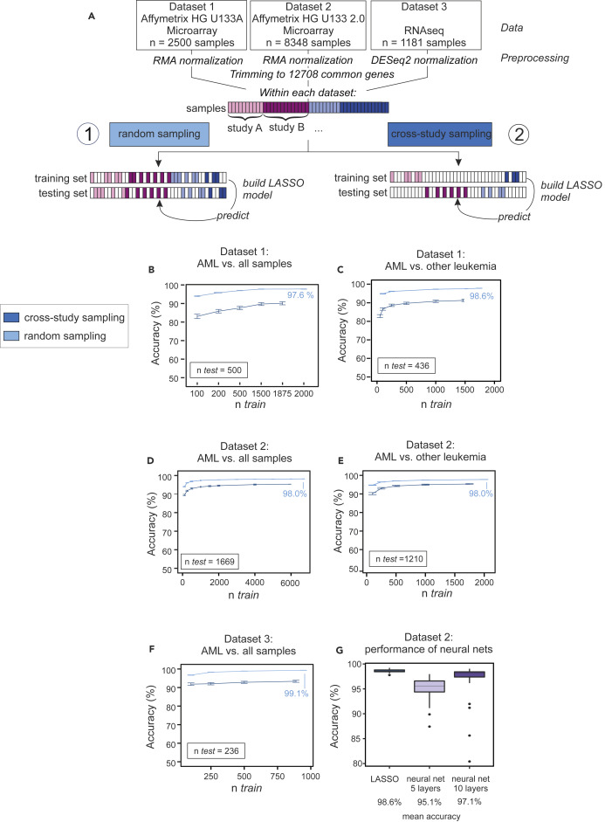
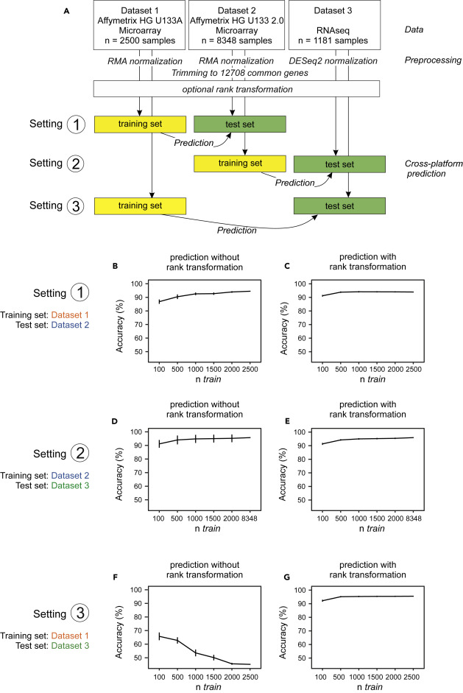
XAI Best-Practices for Omics Data
Comparison of different XAI methods on Acute Myeloid Leukemia Dataset
Modelling strategies for multi-source datasets
Separate modelling of each dataset with different sampling strategies:
random sampling:
random sampling of training and test sets (repeated 100 x) pooled from all studies in one dataset
diverse study-specific effects and sources of study-to-study variation (e.g. batch effects) can pose problems in the context of predictive tests for clinical applications because predictors that perform well within one study may perform worse when applied to data from new studies with implications for practical generalizability
cross-study sampling
sample training and testing sets from different studies, i.e. any individual study from which any sample was included into the training dataset was entirely absent from the test set, and vice versa
Now go to Notebook:
5-Tutorial_XAI_for_RandomForests.ipynb
Cross-dataset (technical platform) evaluation:
clinical pipelines must cope with changes in technological platforms and hence, it is relevant to understand to what extent predictors can generalize not only between studies but also between different platforms
a model is learned using independently normalized data from one platform and then this model, is used (“as is,” with no further fine-tuning) to make predictions using data from a different platform

Slide 40
Agenda
ML Best-Practices for Omics Data
Introduction to eXplainable AI (XAI)
Interpretation with Model-Agnostic XAI Methods
Permutation Feature Importance
SHAP (SHapley Additive exPlanations)
Coffee Break
Interpretation with Model-Specific XAI Methods
Forest Guided Clustering
XAI Best-Practices for Omics Data
Wrap-Up

Slide 41
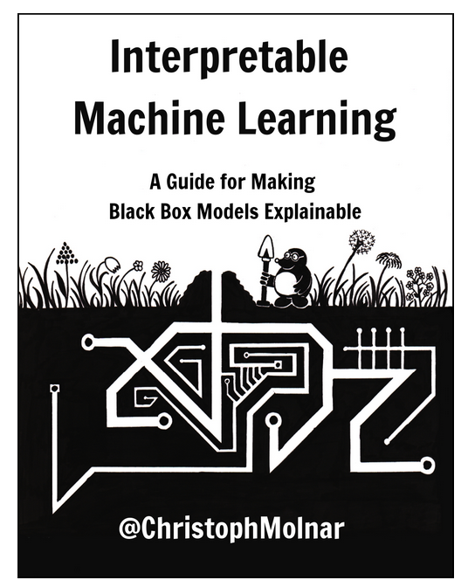


Wrap-Up
Survey
Survey:
https://forms.gle/WcZgrWwFyLfBLKD9A
Further Tutorials:
XAI for CNN/Transformers
Further Reading

